Slide 1
Intelligent Information Retrieval
Week 9 – Query Expansion and Evaluation

Slide 2
Query Expansion

Slide 3

The Concept of Query Expansion
Techniques for modifying the query (fixing or adding to the query in the second search)
Purpose :
Meet information needs.
Provide input (suggestion) to the user regarding the keyword or query that is input.

Slide 4
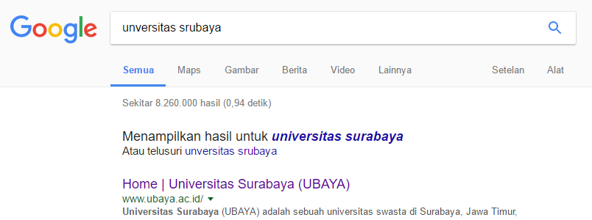

Example

Slide 5
Method
Manual Query Expansion (MQE)
The user himself modifies the query.
This method doesn't help the user at all.
Automatic Query Expansion (AQE)
The system will modify the query automatically without user control.
Types of AQE techniques:

Slide 6

Method
Automatic Query Expansion (AQE)
Global Analysis (GA)
Make use of a thesaurus where the query will be expanded with its synonym.
Example: register => registration, create an account, etc.
Local Analysis (LA)
Local Context Analysis (LCA)

Slide 7

Method
Automatic Query Expansion (AQE)
Global Analysis (GA)
Local Analysis (LA)
The system selects the documents with the highest ranking (closest similarity) and will generate a new query.
Local Context Analysis (LCA)

Slide 8
Method
Automatic Query Expansion (AQE)
Global Analysis (GA)
Local Analysis (LA)
Local Context Analysis (LCA)
The new technique combines GA and LA. Based on the research of Xu and Croft (1996), LCA provides better effectiveness and consistency than GA or LA.

Slide 9

Method
Interactive Query Expansion (IQE)
The system and users will interact in the query expansion process.
One of the familiar and widely used IQE techniques is Relevance Feedback (RF).

Slide 10

Relevance Feedback (RF)
The user is presented with the results of searching and the user marks the relevant documents according to him.
The system selects the important term (highest weight) in the document marked by the user, then adds the term to the query modification process.

Slide 11
Relevance Feedback (RF)
Three Relevance Feedback (RF) methods:
User Judgement (Explicit RF)
User Behavior (Implicit RF)
Top K Retrieved (Blind/Pseudo RF)

Slide 12

Relevance Feedback (RF)
User Judgement (Explicit RF)
Obtained from relevant assessors
The relevant assessor in question is an assessment that is interpreted by the user himself (relative assessment) to the results of searching.

Slide 13

Relevance Feedback (RF)
User Behavior (Implicit RF)
Observing user behavior, such as the length of time the user reads a document or browsing or scrolling or bookmarking a page, etc.

Slide 14

Relevance Feedback (RF)
Top K Retrieved (Blind/Pseudo RF)
How it works: take the top K document search results, then take the term with the highest weight for the query modification process.
The value of K is determined by the programmer.

Slide 15
Evaluation IR System

Slide 16
Introduction
Two important aspects of evaluation in IR systems: effectiveness and efficiency.
Effectiveness relates to the accuracy of search results documents.
Efficiency is related to the speed of the search process.

Slide 17


Effectiveness
What is measured: all relevant and irrelevant documents
Measurement techniques: Accuracy, Precision, and Recall

Slide 18

Confusion matrix
 | Relevant | Not Relevant | Total
Retrieved | A | B | A+B
Not Retrieved | C | D | C+D
Total | A+C | B+D | A+B+C+D

Slide 19
Measurement
Accuracy (how accurate the IR system is built)
Accuracy = (A+D) / (A+B+C+D) x 100%
Recall (the system calls the relevant documents)
Recall = A / (A+C) x 100%
Precision (the system does not call irrelevant documents)
Precision = A / (A+B) x 100%

Slide 20
Case Example
Bejo is a programmer who has finished working on a project on the system of searching for scientific journals at the University of Maju Tak Gentar. Bejo wants to evaluate the system he has created before it is presented to university leadership.
The collection of journals at the University is 100 journals and the query used for testing is "world stock prediction", the search results data are as follows:

Slide 21
Case Example
 | Relevant | Not Relevant | Total
Retrieved | 20 | 20 | 40
Not Retrieved | 20 | 40 | 60
Total | 40 | 60 | 100
Accuracy =(A+D) / (A+B+C+D) x 100% = 60/100 x 100% = 60%
Recall = A / (A+C) x 100% = 20/40 x 100% = 50%
Precision = A / (A+B) x 100% = 20/40 x 100% = 50%
Note: The number to be retrieved is self-determined, for example = 40

Slide 22
Conclusion
The ideal conditions for the effectiveness of an IR system are:
High accuracy value (close to 100%) OR
Equal recall and precision ratio (1:1)
Conclusion from the previous case: IR system is effective

Slide 23
Questions??

